Slide 1
Atliq Sales Insights Dashboard
(Streamlining Sales tracking with SQL and Power Bi for dynamic Market Growth)

Slide 2
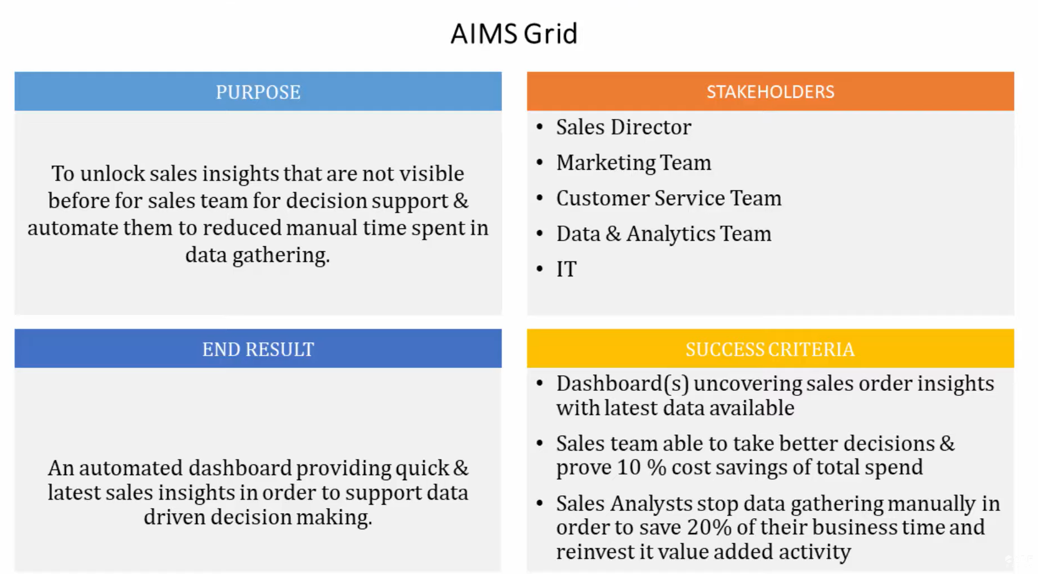
Project Alignment with AIMS Grid
“Aims Grid Blueprint: Mapping project vision to measurable outcomes"

Slide 3
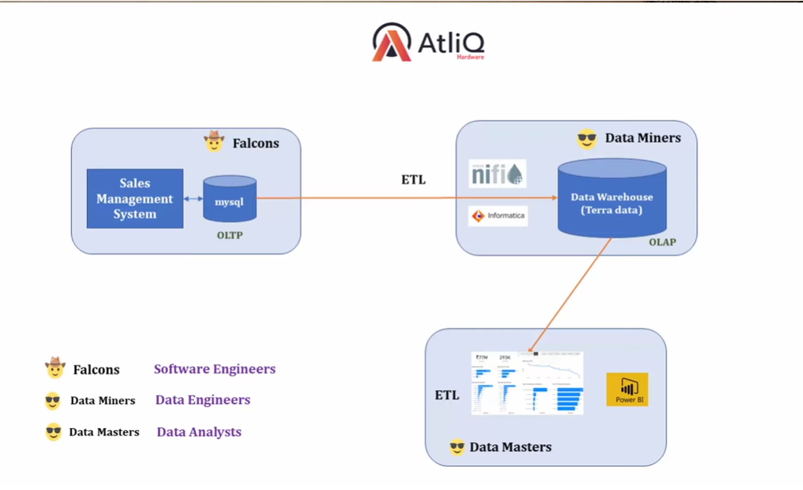
Sales Data Intelligence Engine
“OLTP to OLAP Pipeline: Optimized Data Warehousing for Sales Analytics”

Slide 4
Requirement:
Client wants to create a Sales Insights Dashboard to track and analyze Sales Performance across different business. dimensions.
Primary KPIs
Total Revenue
Total Sales Quantity
Secondary KPIs
Revenue by Markets (Regions/Cities)
Sales Quantity by Markets
Monthly/Yearly Revenue Trends
Top Customers by Revenue
Top Products by Revenue

Slide 5
Process Involved in the Sales Analysis of Atliq Hardware
✅ Collected raw sales data from external sources:
Imported sales transactions (Revenue, Quantity, Product, Customer, Market) into SQL Database.
🧹 Data cleaning & preparation in SQL:
Removed duplicates, handled missing values, standardized product codes and market names.
📊 Identified Key Metrics (KPIs):
Primary KPI’s: Total Revenue, Sales Quantity.
Secondary KPI’s: Sales by Markets, Products, Customers, and Monthly Revenue trends.
📈 Performed trend analysis:
Used SQL Queries and Power Bi visuals to analyze Revenue Movement across months.
🛒 Segmented data by business dimensions:
Broke down sales by region, product, and customer to identify top contributors and low performers.
💡 Built interactive dashboard in Power BI:
Created visuals for revenue by market, sales qty by market, top customers, top products, and revenue trends.

Slide 6
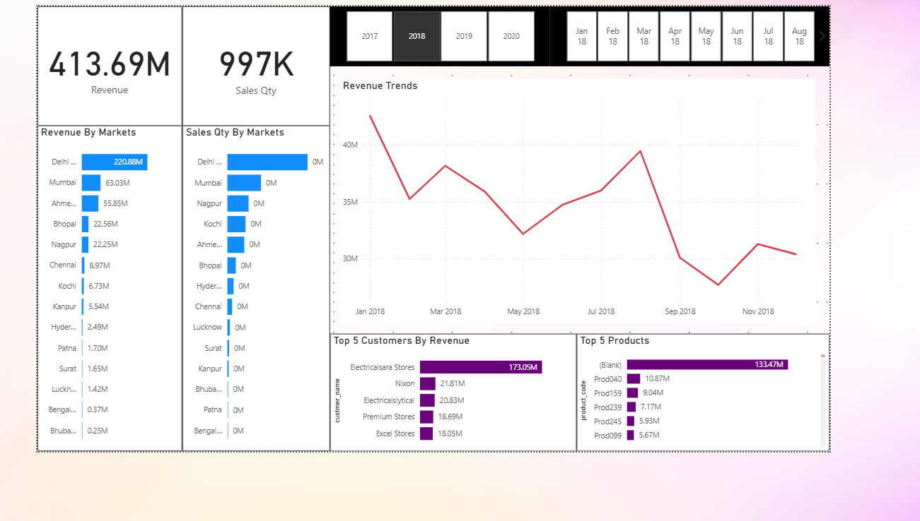
Final Dashboard

Slide 7
Key Insights
Sales were not evenly distributed – a few markets (like Delhi) contributed a major share of revenue.
Customer base showed concentration – a handful of key customers drove most of the business.
Product mix revealed that a few top products generated maximum revenue, while many others underperformed.
Sales trends indicated seasonal fluctuations with certain months showing clear peaks and dips.
Regional analysis highlighted dependency on specific markets, suggesting both opportunities and risks.
Overall, the dashboard provided actionable insights into where, when, and who contributes most to sales performance.

Slide 8
Conclusion
    This project transformed raw sales data into a structured and interactive dashboard.
The Analysis revealed:
-- Regional dependency on Key Markets
-- Customer Concentration Risk
-- Product-level insights for optimization
-- Seasonal fluctuations impacting demand planning

Slide 9
THANK YOU

